Slide 1
ACCY577 Machine Learning for Accounting
Module 2: Fundamental Algorithms I
Linden Lu

Slide 2
Module 2: Fundamental Algorithms I
Linear Regression
Logistic Regression
Decision Tree

Slide 3
Lesson 1: Linear Regression
Supervised Learning
Predict continuous output
Assume linear relationships between input and output
Feature scaling is normally not needed

Slide 4
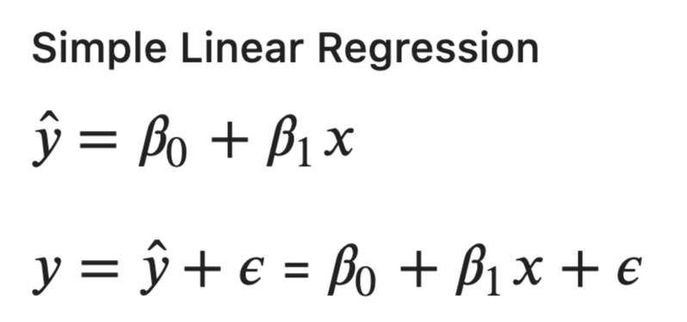
Linear Regression

Slide 5
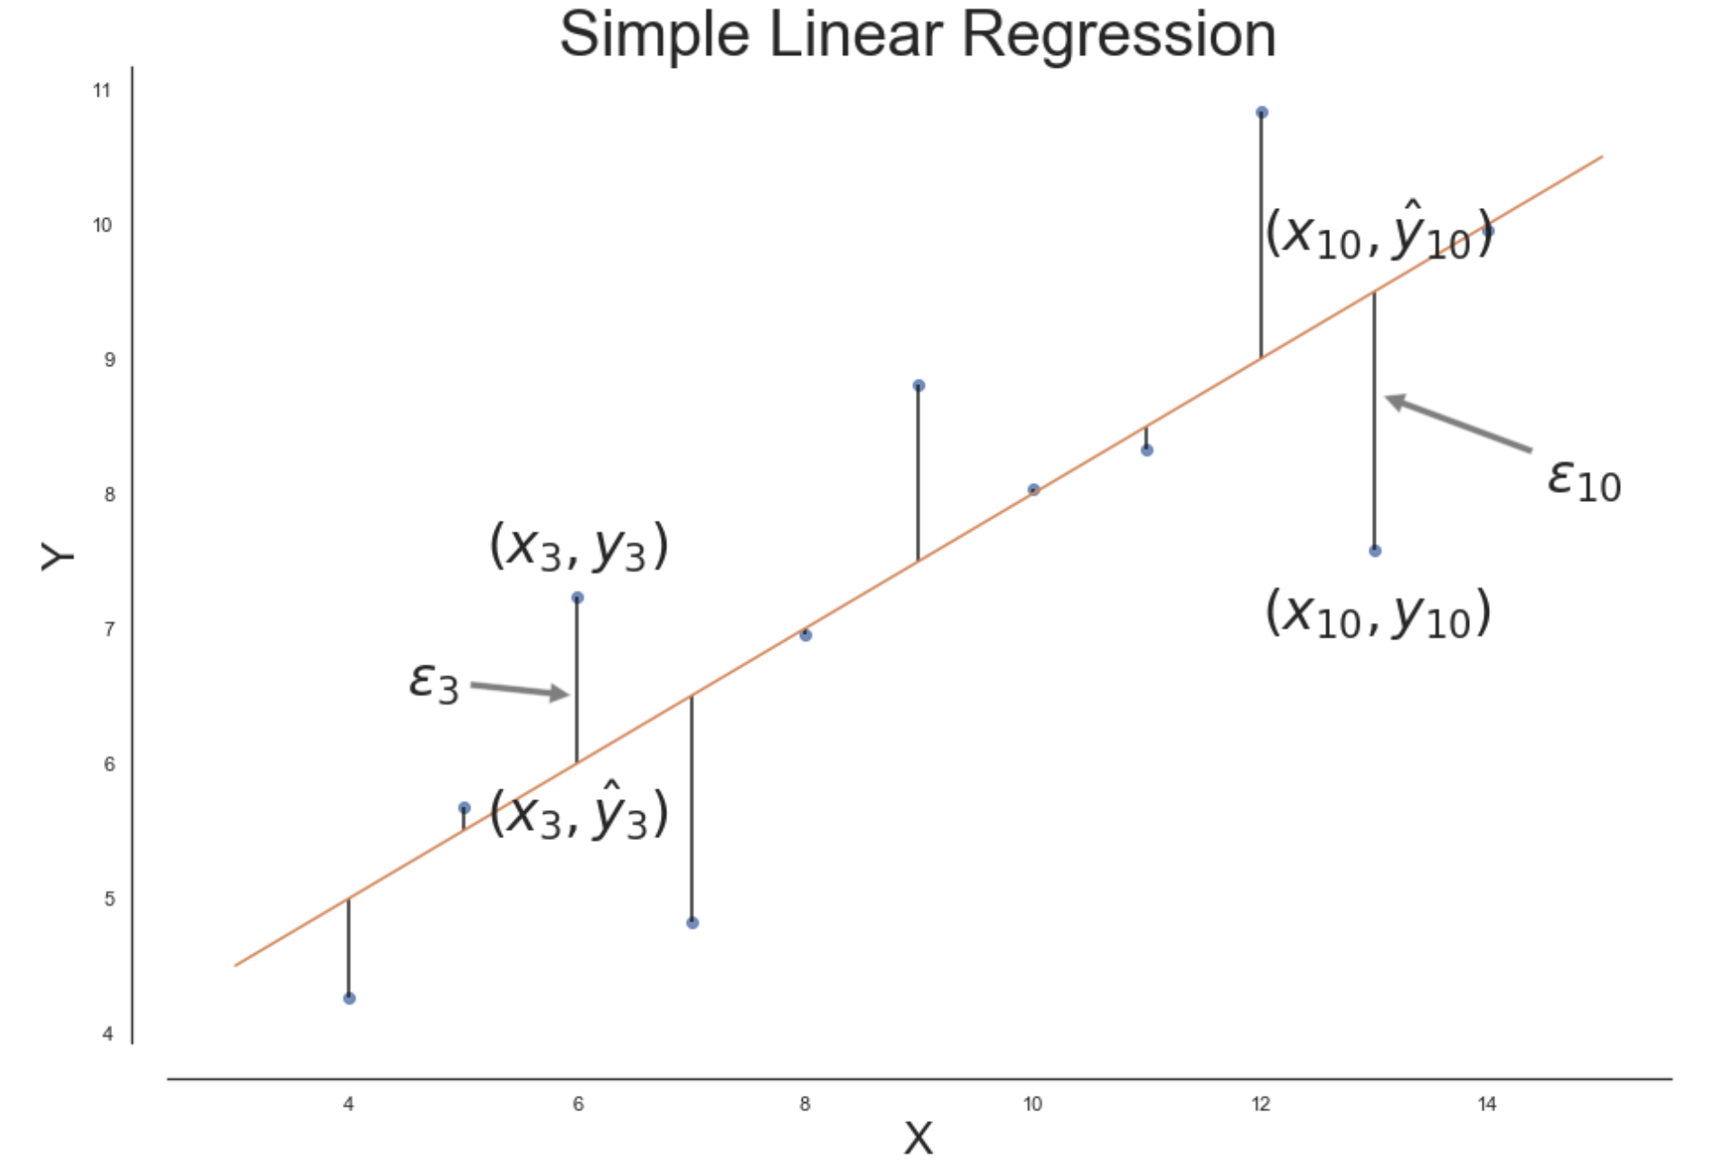
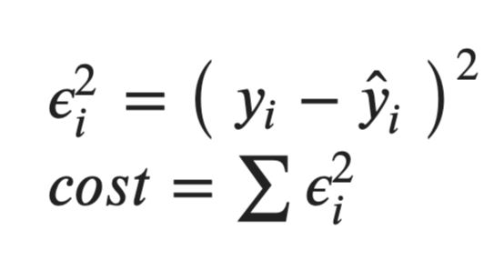
Cost Function

Slide 6
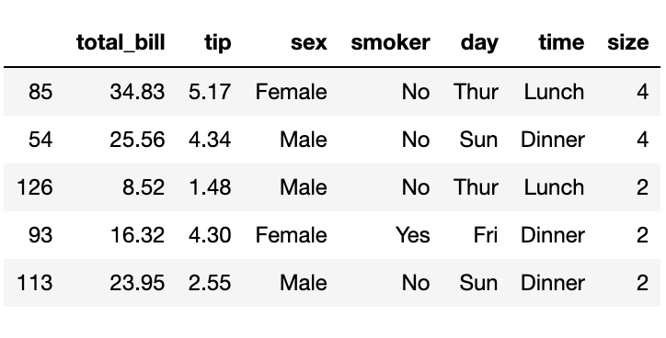
Tips Dataset

Slide 7
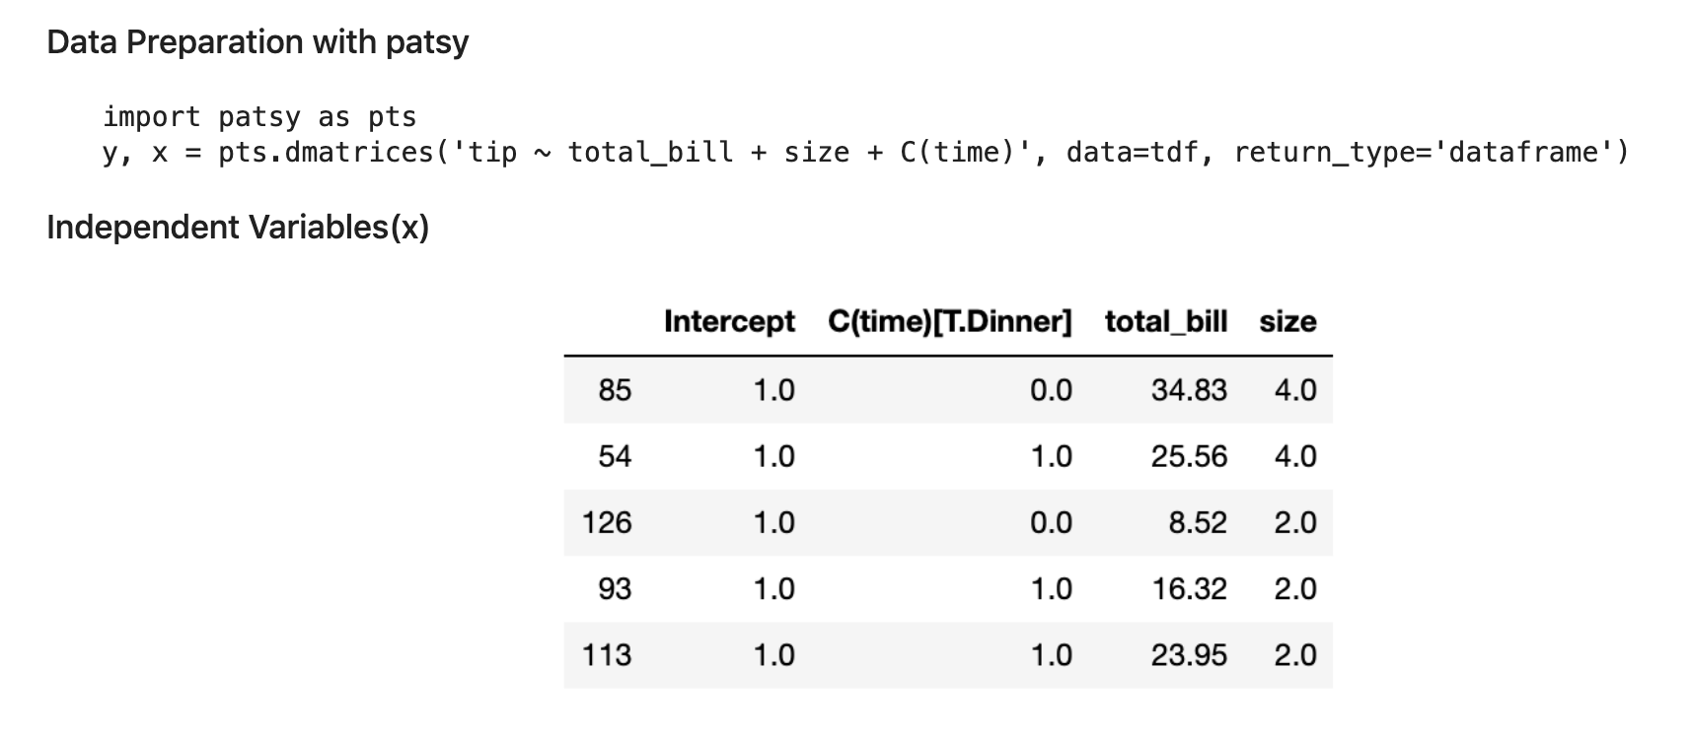
Data Preparation

Slide 8
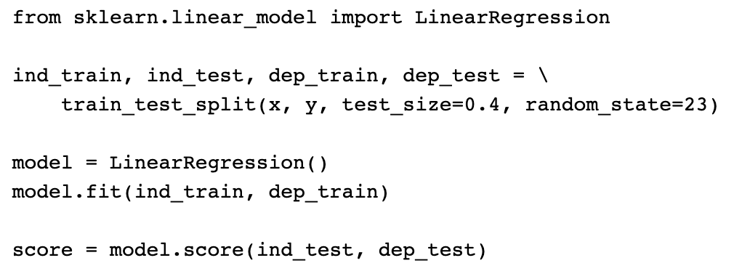
Scikit Learn LinearRegression Model

Slide 9
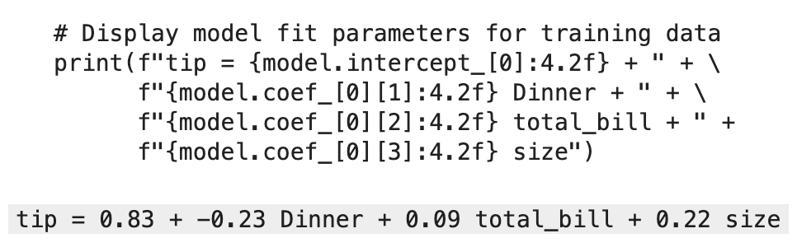
Linear Regression Formula

Slide 10
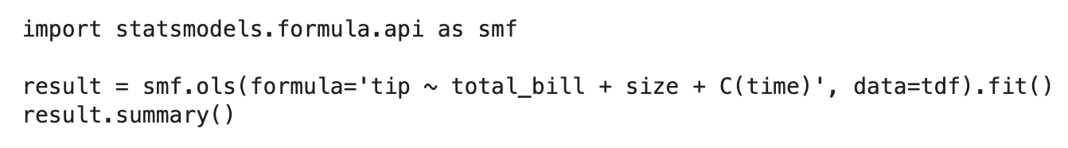
Statsmodels Linear Regression

Slide 11
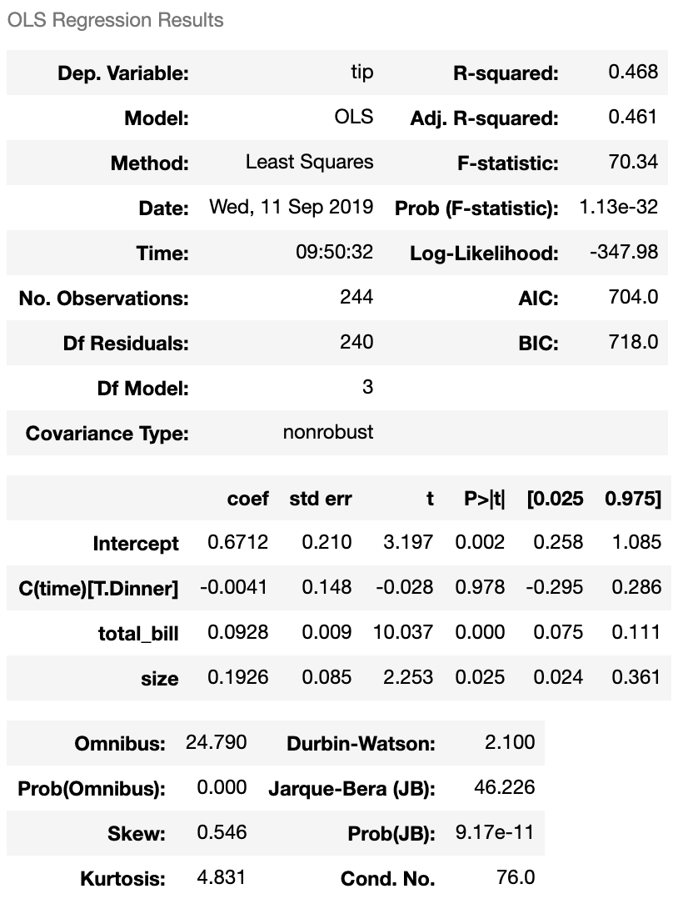
Linear Regression Result

Slide 12
Lesson 2: Logistic Regression
Supervised learning
For classification problems
Feature standardization preferred

Slide 13
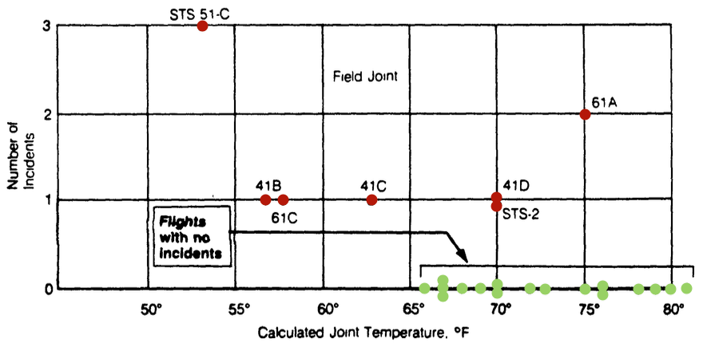
Challenger Disaster Investigation

Slide 14
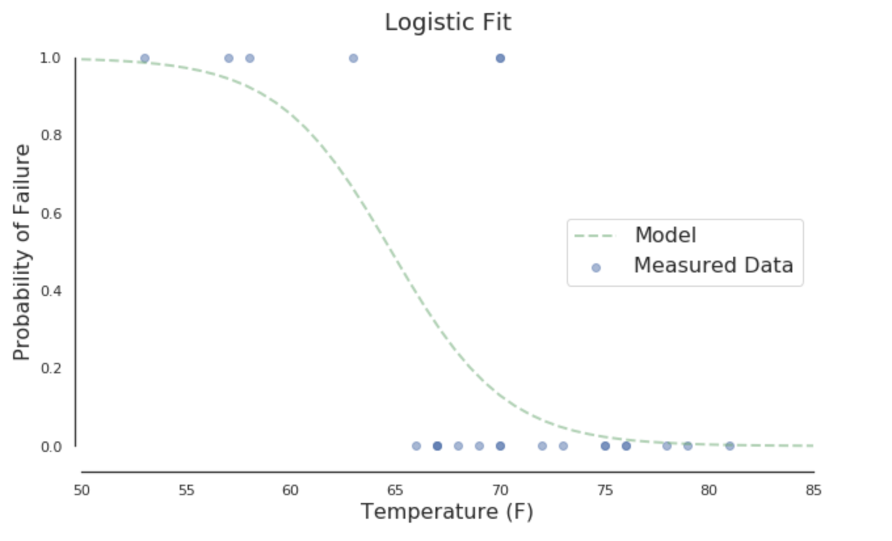
Map to Probability

Slide 15
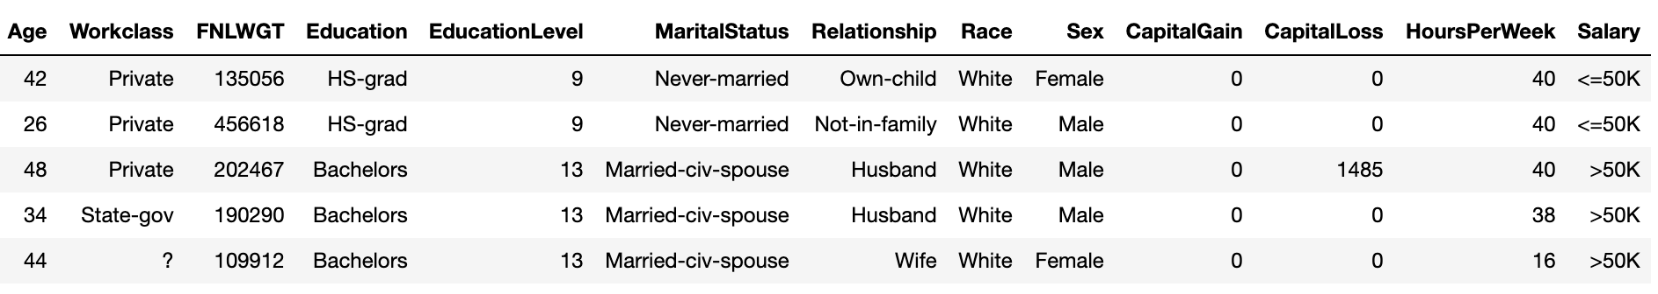
Adult Income Dataset

Slide 16
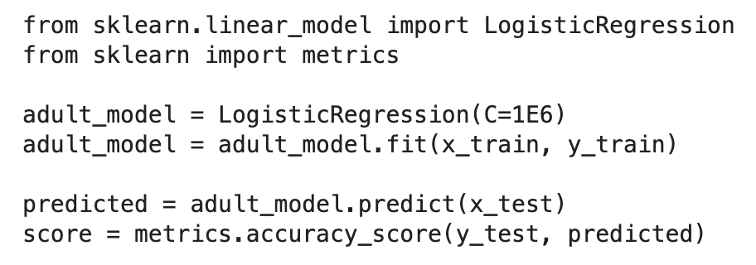
Scikit Learn LogisticRegression model

Slide 17
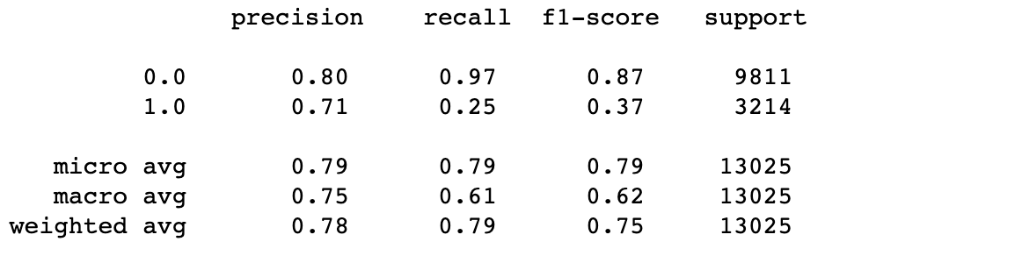
Classification Report

Slide 18
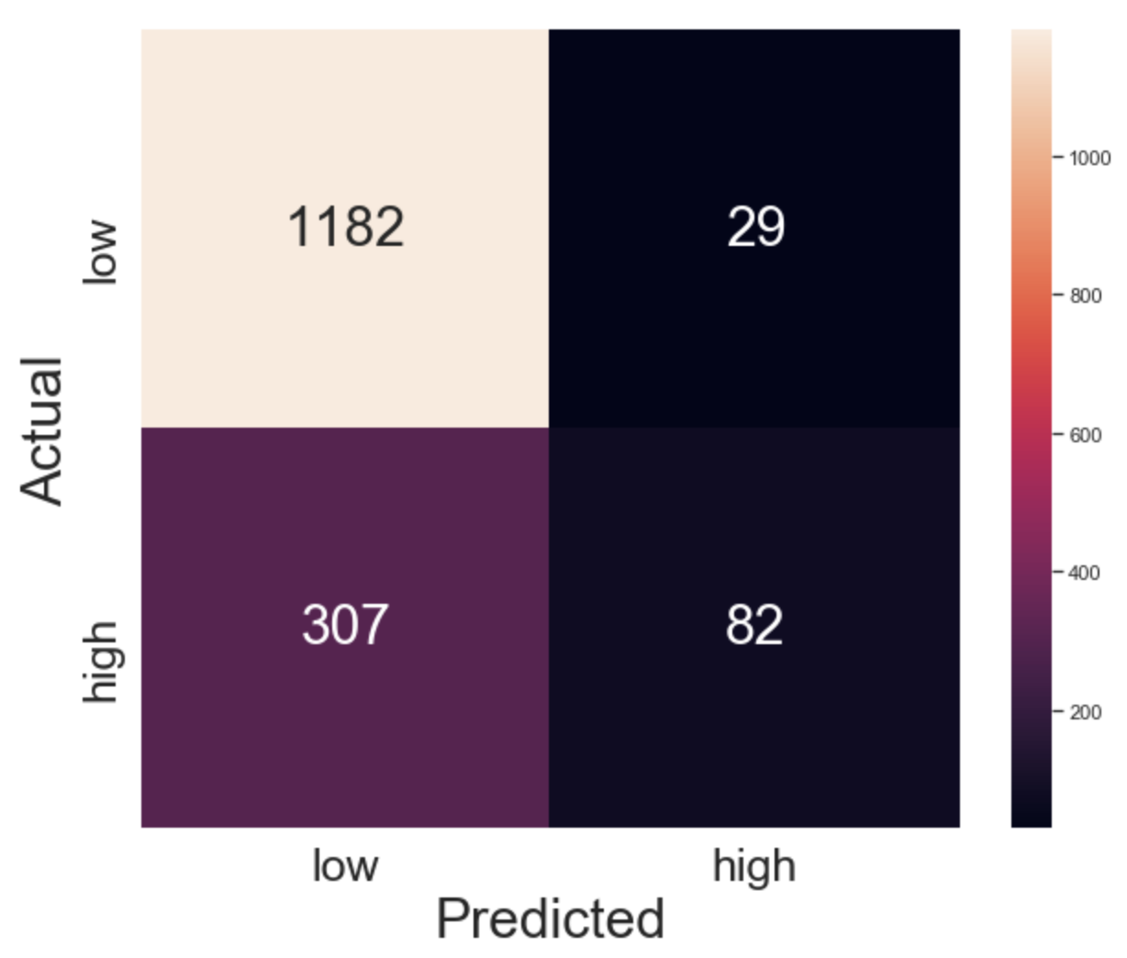
Confusion Matrix

Slide 19
Lesson 3: Decision Tree
Supervised learning
For both classification and regression problems
Can handle categorical feature(numerical)
Feature scaling is not needed

Slide 20
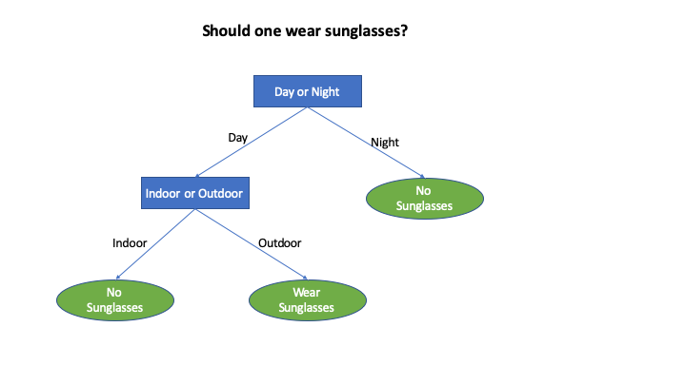
Decision Tree

Slide 21
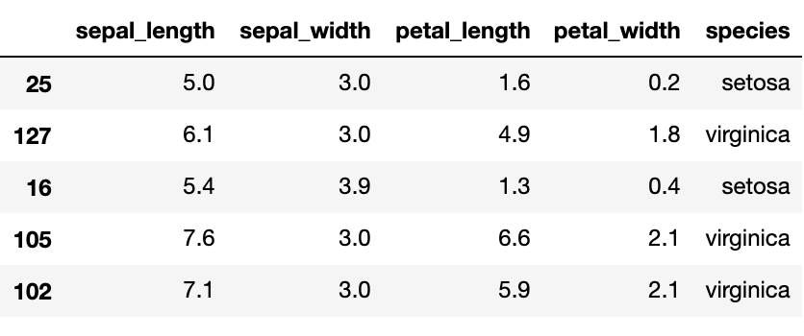
Iris Dataset

Slide 22
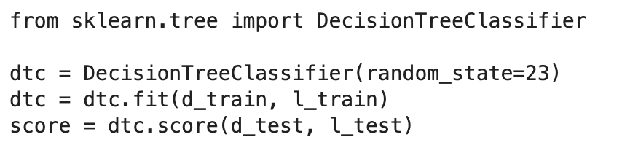
Scikit Learn Decision Tree Classifier

Slide 23
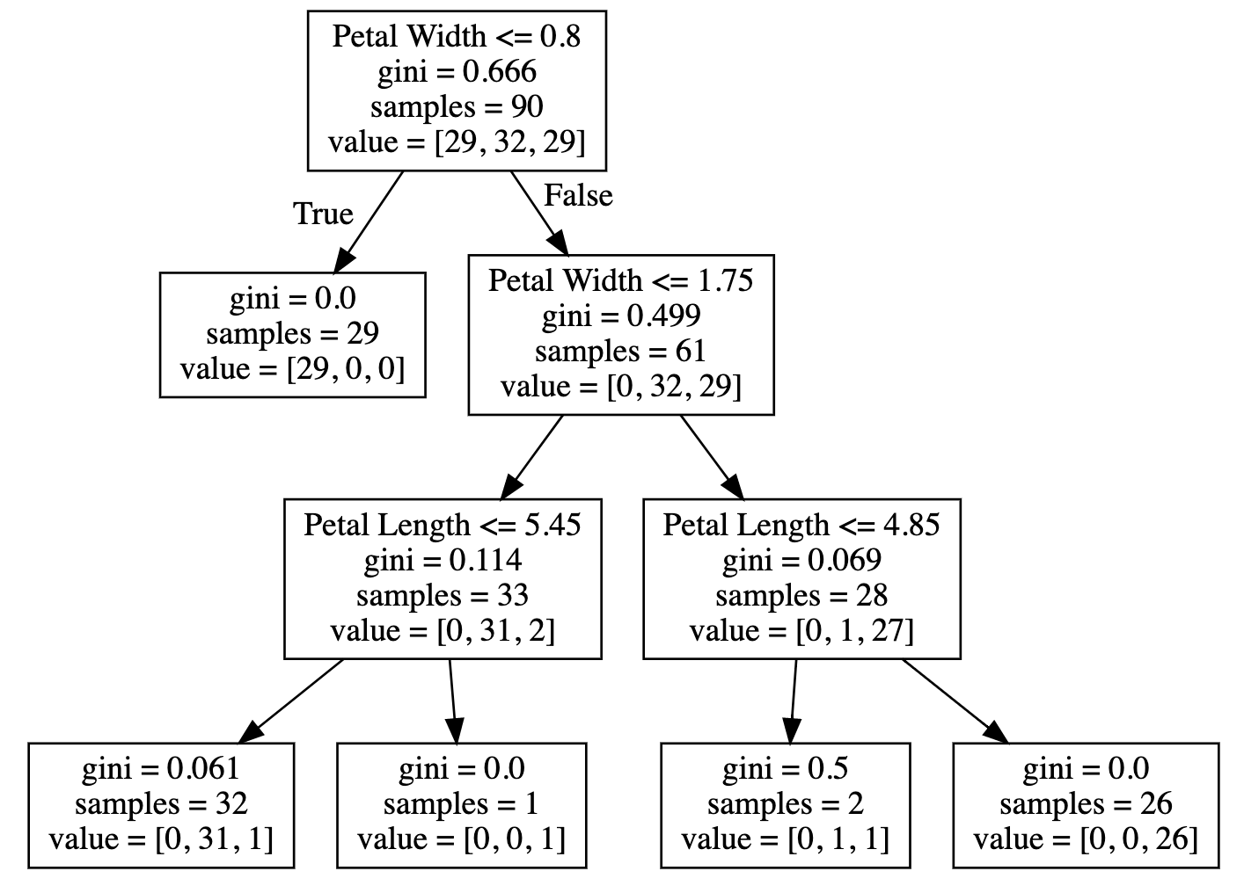
Visualize Decision Tree

Slide 24
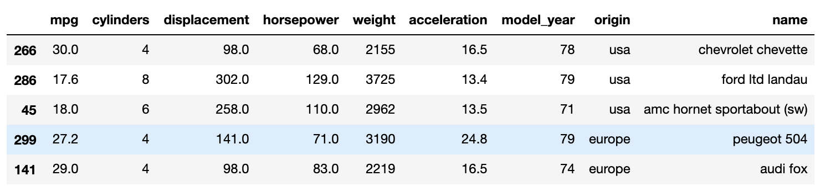
Auto MPG Dataset

Slide 25
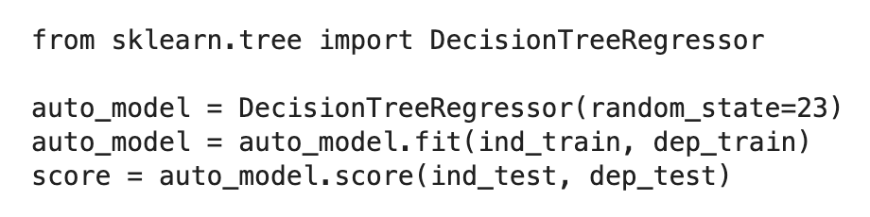
Scikit Learn Decision Tree Regressor

Slide 26
Module 2 Review
Linear Regression
Logistic Regression
Decision Tree

Slide 27
Module 2 Review
Continuous Features
Scaling not needed
Categorical Features
Create dummy variables
Linear Regression
Logistic Regression
Label encoding
Decision Tree

